Slide 1
Education Challenge
Best Classroom Suggestions
Get Best Practices into Every Classroom
Make Our Classes So Good
EVERYONE Will Want to Take Them
Revised 2026
Revised May 09, 2026
Mike Brough
Flotilla 24
© 2008 – 2026 captnmike.com / Mike Brough

Slide 2
Keep the Class Interesting
Tell Lots of Sea Stories
Keep the Class on the Edge of Their Seats
Talk Softly & Mumble
Just Read the PowerPoints
Read the Colregs for the Rules of the Road
Read The Instructor Notes To The Class
OK - THESE ARE NOT “BEST PRACTICES” ...
© 2008 – 2026 captnmike.com
Notes:
These are NOT the best practices, but they are common errors made by instructors
Go down the entire list with a straight face before letting the class in on the not the correct way to do things

Slide 3

Keep the Class Interesting
For Real
Use the Teaching Kit
Use Teaching / Class Aids
Rotate Instructors
Borrow Instructors from other Flotillas
(Remember to Say Thank You!!)
Division Sponsored / Multi-Flotilla / Non-Instructor POC …
© 2008 – 2026 captnmike.com

Slide 4
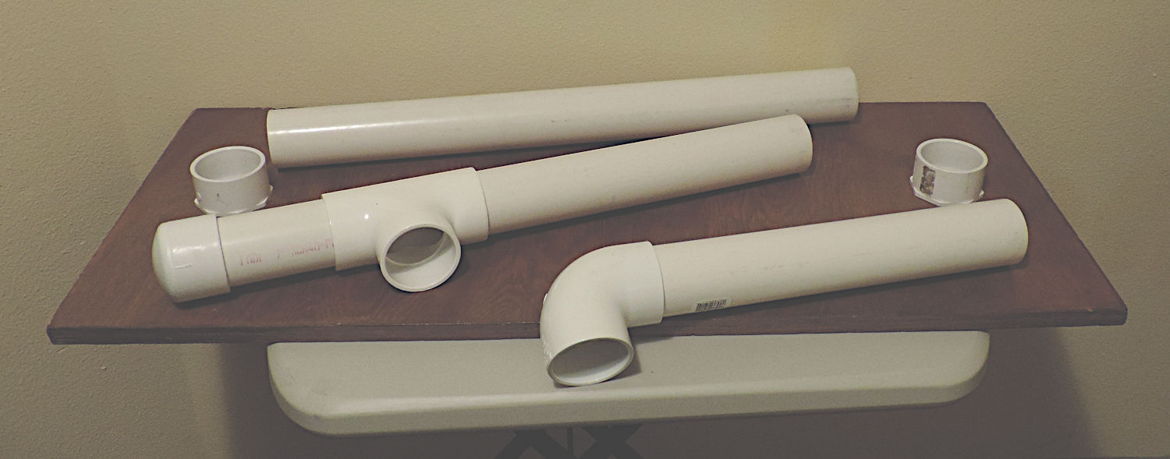
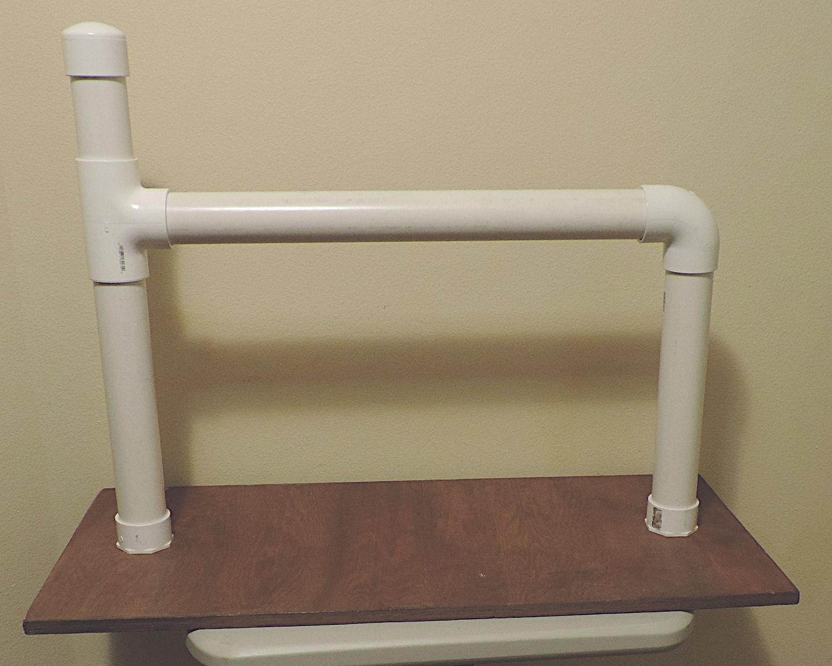
Marlinespike
© 2008 – 2026 captnmike.com
Notes:
For tying knots in the front of a class (or at a public information booth)
Comes apart, place in front of the instructor facing the class
Two-inch PVC all slip joints except the sockets that are Hot-Glued into the base
CAUTION: the instructor will be tying the knots upside down and sort of backwards, so PRACTICE!!

Slide 5
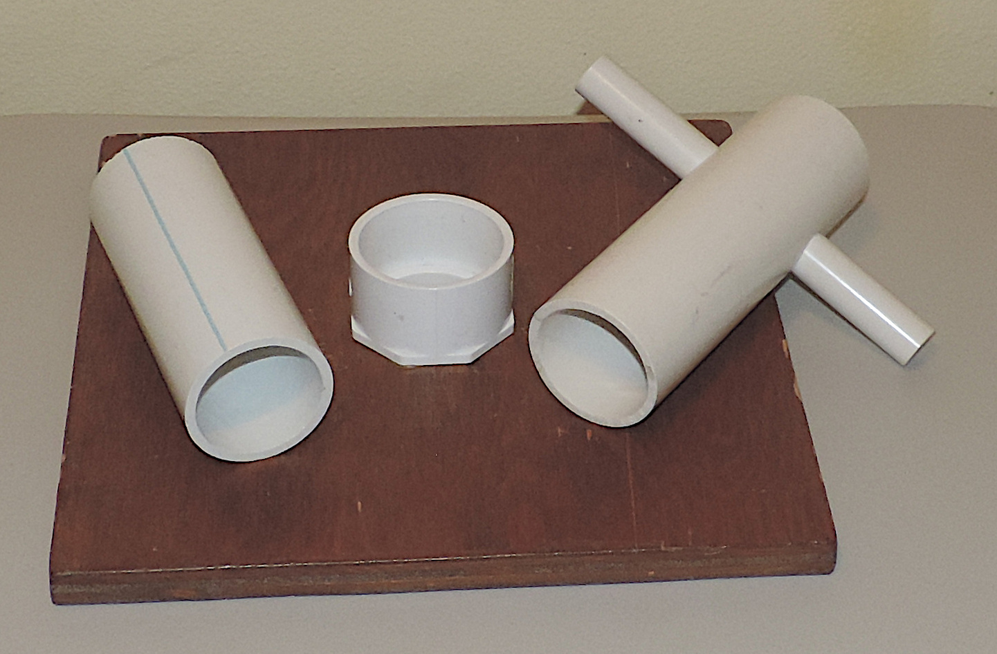
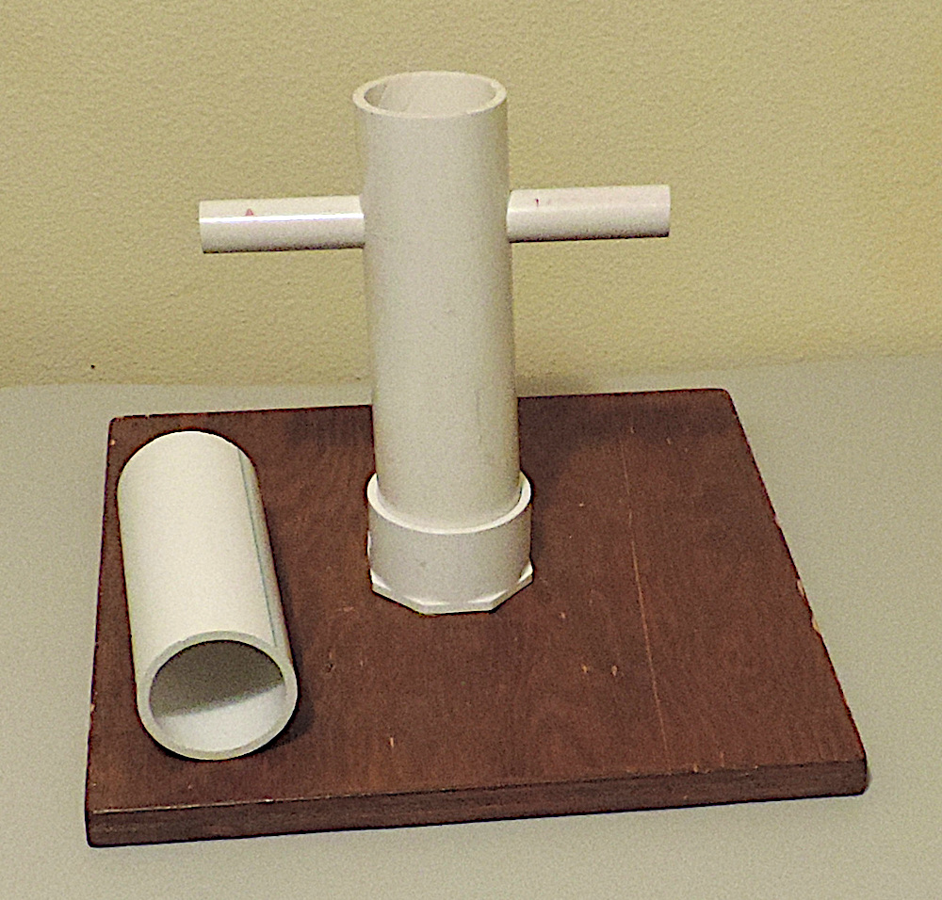
Sampson Post & Post
© 2008 – 2026 captnmike.com
Notes:
Plain post and Samson Post for tying knots, Two-inch PVC, designed to come apart for ease of transport
The socket was Hot-Glued into the base
Put your favorite stain on the base, looks better and seems to reduce chip and splinters

Slide 6
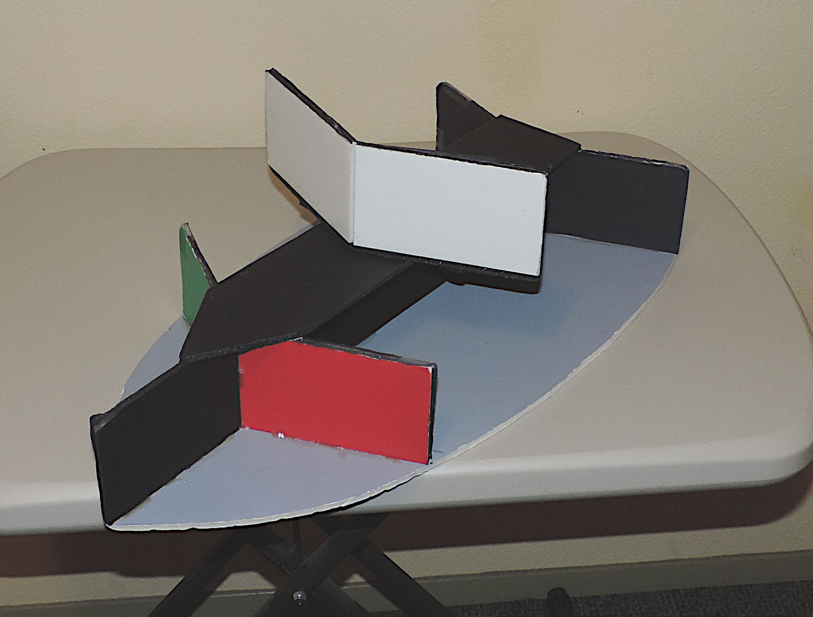
Navigation Lights
© 2008 – 2026 captnmike.com
Notes:
Cardboard boat made out of Foam Core –
Angles match navigation lights on a boat
The white masthead light comes off to demonstrate an unpowered vessel / sailboat
Rotate the boat around so the class can see how the lights change

Slide 7
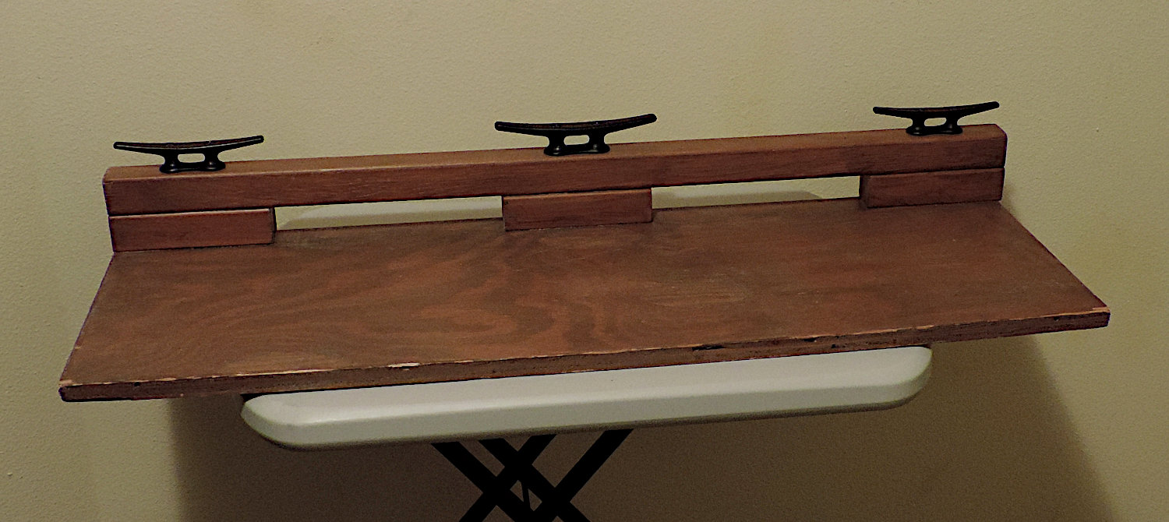
Bull Rail – 36” Wide
© 2008 – 2026 captnmike.com

Slide 8
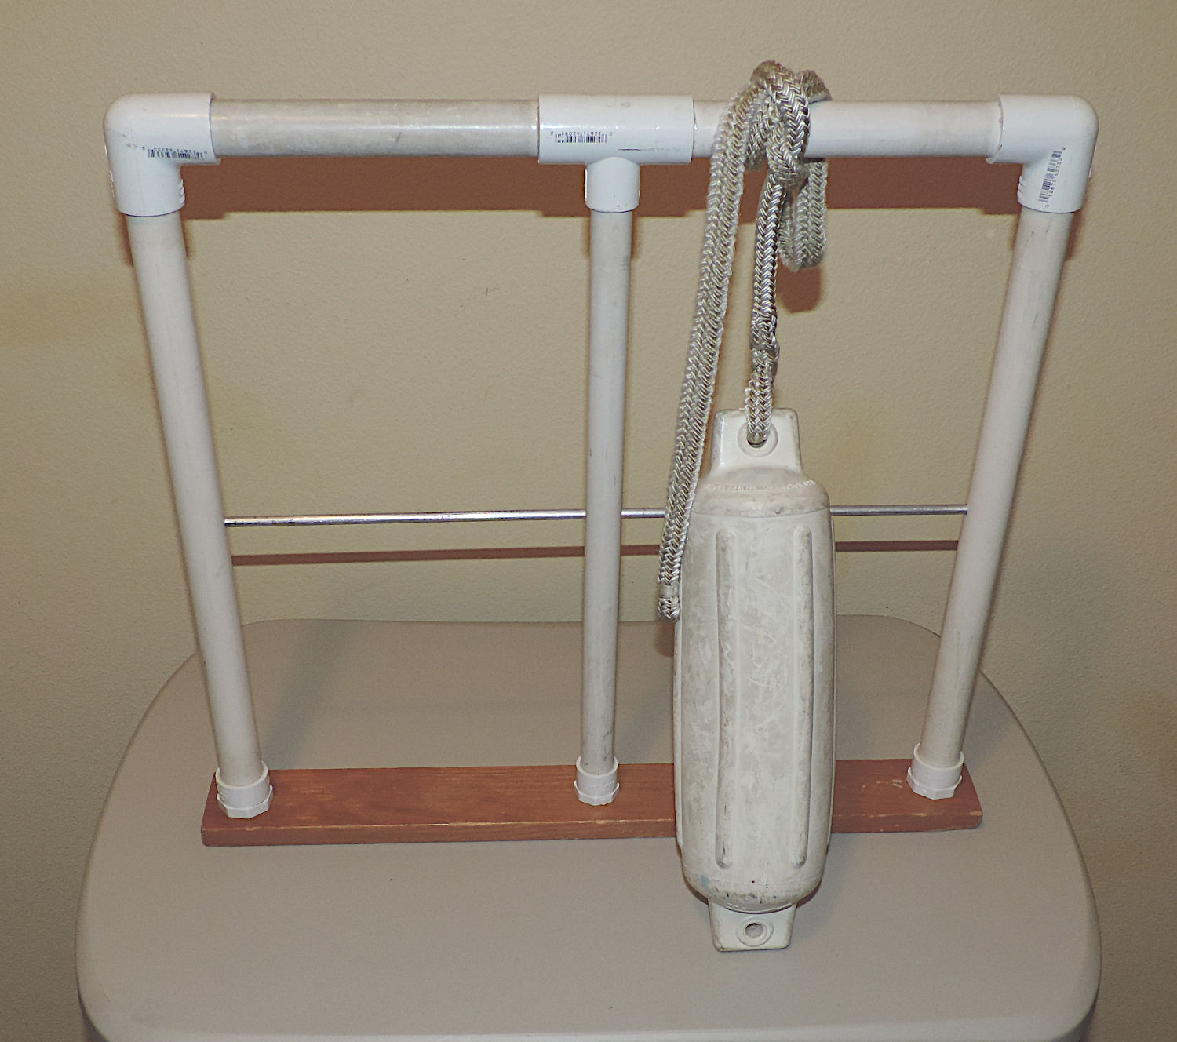
Lifeline – Clamp to Table
© 2008 – 2026 captnmike.com
Notes:
Fake lifeline – glued together with Hot-Melt for the base sockets
Needs to be clamped to a table, some type of different base or attachment could also be made for stability
Nice for demonstrating knots in a classroom, also works nice at a public education booth, the public likes to touch things
The horizontal silver rod is aluminum, it goes through the center stanchion but only through one side of the side stanchions, be careful when drilling the center stanchion to get the hole centered.

Slide 9
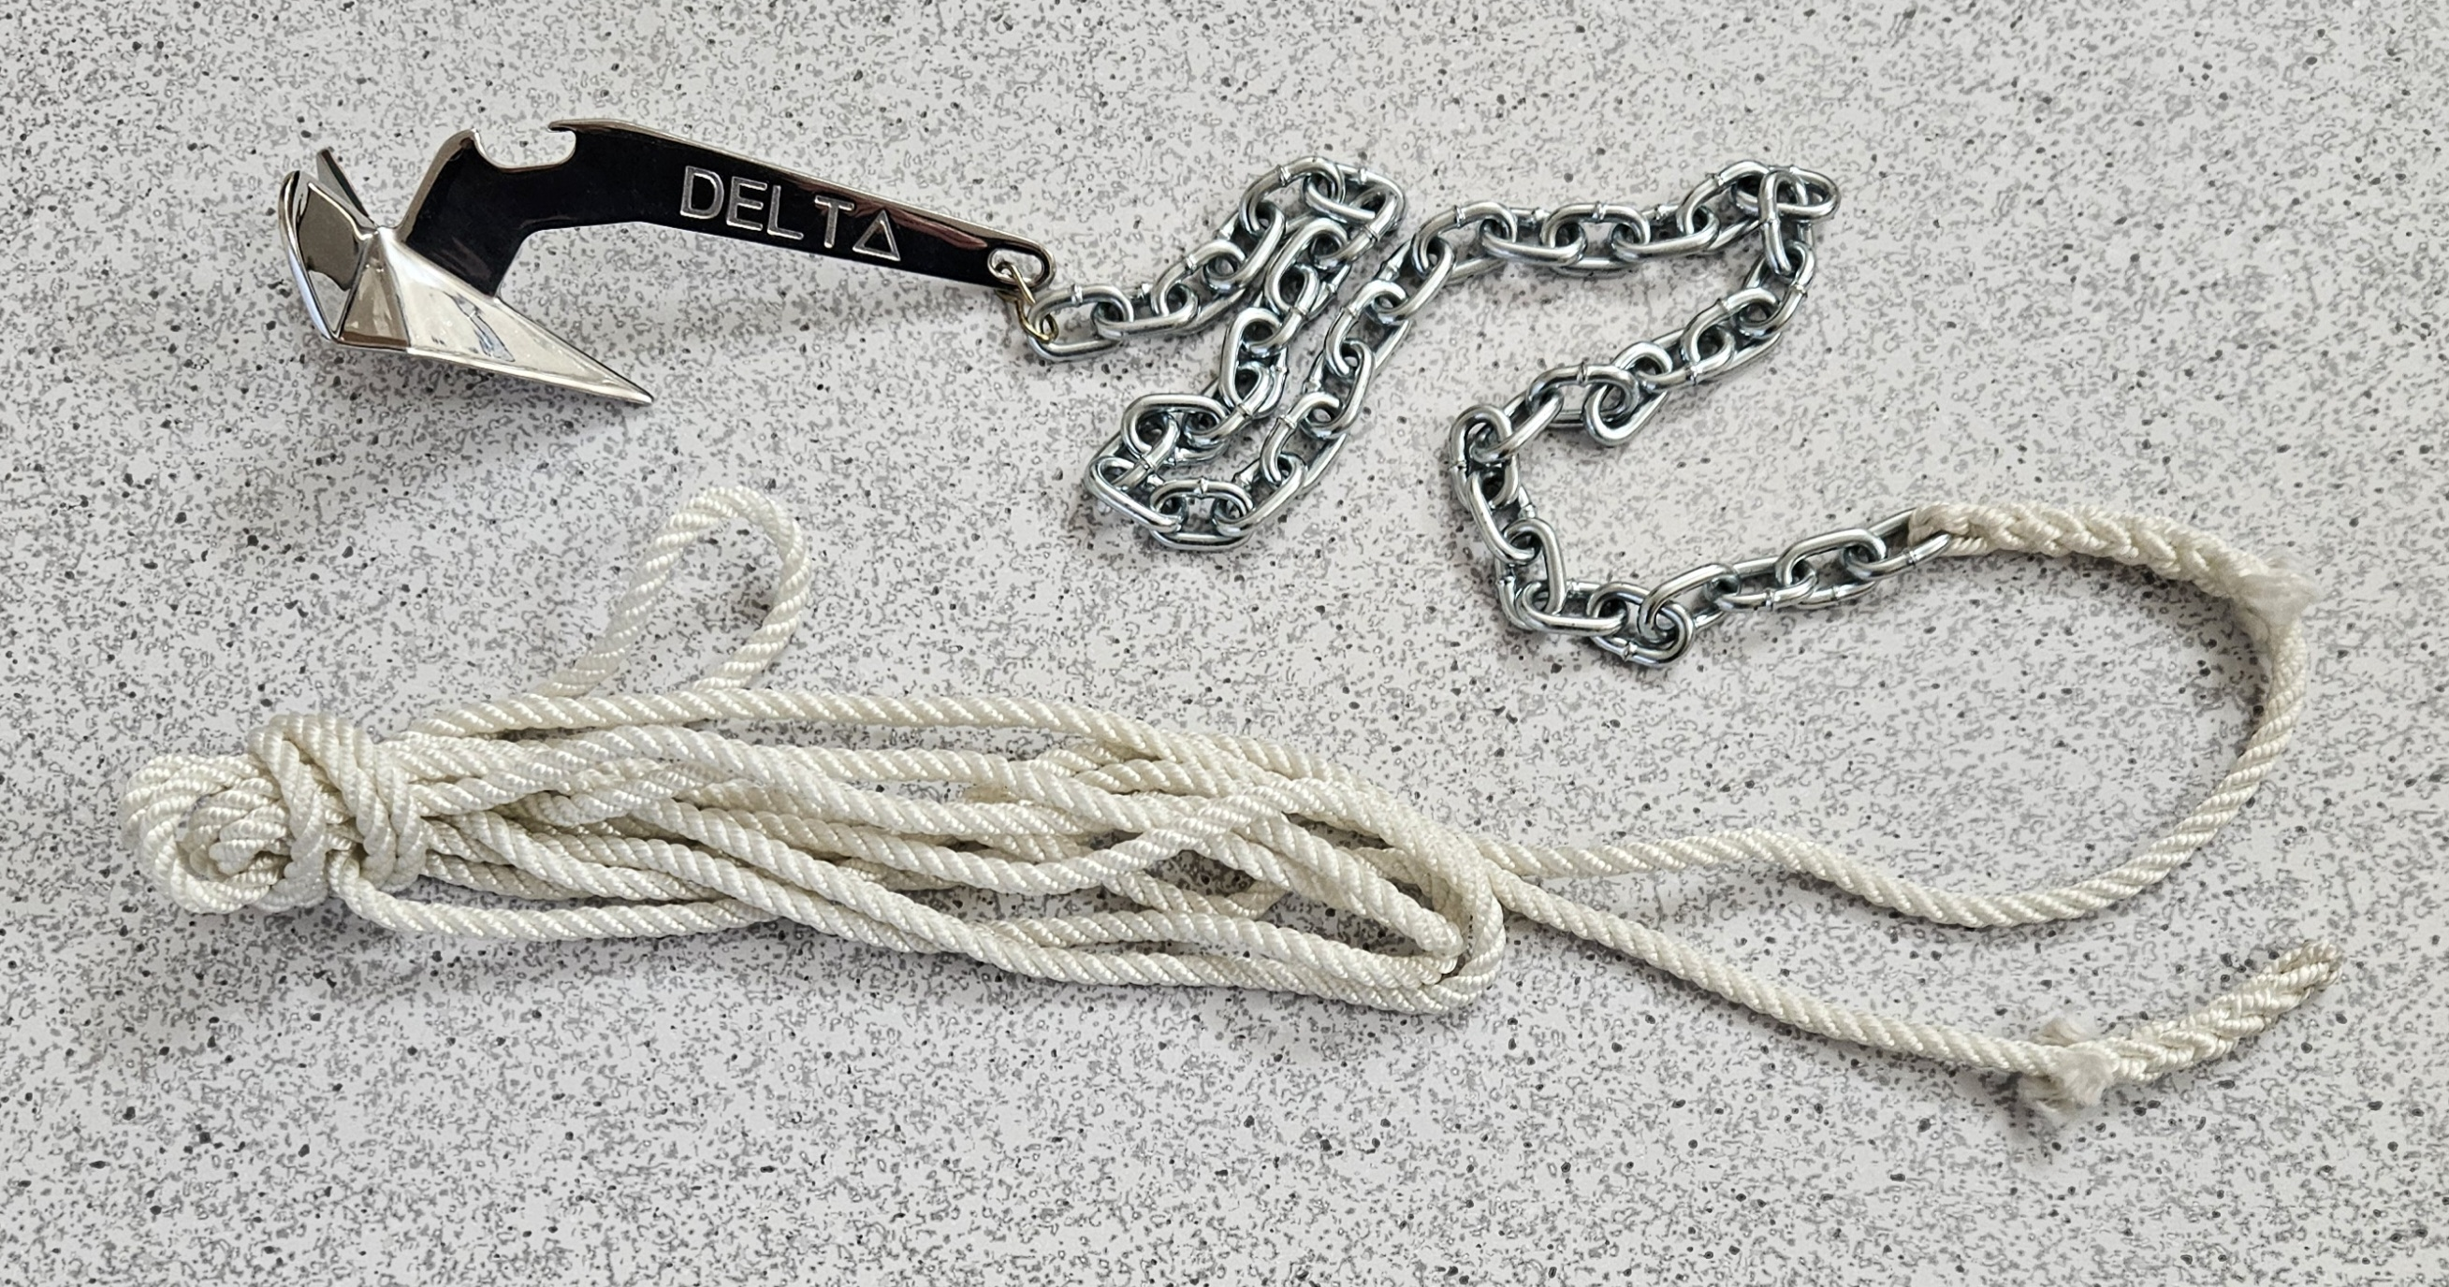
Delta / Lewmar Bottle Opening Anchor
25 Inches Of Chain From Hardware Store, Link Chain to Anchor, Six Feet Of 3/16-inch line, Backsplice To Chain, Backsplice Bitter End …
© 2008 – 2026 captnmike.com

Slide 10
More Keep the Class Interesting
Use Your Best Instructors
Use Every Instructor That Wants to Help
If an Instructor Volunteers – USE THEM
Use the Strengths of Your Instructors
Use the Whole Flotilla...
© 2008 – 2026 captnmike.com

Slide 11
Instructor Preparation
Review the Material
Practice speaking class material out loud
Review the Material of the other Instructors
Personalize the Instructor Guides
Visit Other Classes - Borrow Good Ideas ...
© 2008 – 2026 captnmike.com

Slide 12
Instructor Preparation
Gold Star Slides you want to emphasize
Add / Revise Slides for Problem Concepts
Check List of What to Bring to Class
Set Items out the Night Before
Chapter 3 Rules & ATONS
Combined National & Local Slides
Added a few Slides
Doubled Instructor Notes ...
© 2008 – 2026 captnmike.com

Slide 13
Instructor Preparation III
Have Backup Computer & Projector
120v Extension Cord & Splitter
Have The Class on a USB Stick
USB Splitter
HDMI Extension Cable
Spare Dry Erase Markers (Markers in some
rooms are dried out)…
© 2008 – 2026 captnmike.com

Slide 14
Customize the Power Points & Class
to Your Area
Columbia River
Lake Union, Lake Washington
VTS Lanes - Handouts
Bridges
Ballard Locks
One of the Best Free Shows in Town
Locks Handouts
Locking Through Class
Web Site With Videos...
© 2008 – 2026 captnmike.com

Slide 15
Give Handouts With Local Knowledge
Important Seattle Area Boating Information
Lake Washington, Lake Union and Speed Zones
Bridges in Seattle
Visit://www.captnmike.com
Make Your OWN Local Information …
© 2008 – 2026 captnmike.com

Slide 16
Teach Other Classes
Use ABS to Interest Students in other Classes
4 Hour Basic Navigation Class with Local Charts
GPS For Mariners
How to Read a Nautical Chart
You Can Have A custom Local Class
Intro To Rules Of The Road (See My One Page
Summery With Test…
© 2008 – 2026 captnmike.com

Slide 17
In the Classroom
Ration the Handouts
One Set per Person or Family Whichever is Less
Extra Copies For: Friends, Relatives, Coworker
Make Every Handout an
Advertisement for Our Classes
Sticker Identifying U.S. Coast Guard Aux
Give out Handouts and Supplies
BEFORE the Class Starts...
© 2008 – 2026 captnmike.com

Slide 18
In the Classroom II
Learn & Know the Students Names & Boats
What do they Want from the Class??
Flow Smoothly –
Don't Stomp on Other Instructors
Don't be a “Speed it Up Cowboy”
Use a Wireless “Presenter”
Untether Yourself from the Keyboard...
© 2008 – 2026 captnmike.com

Slide 19
In the Classroom III
Put Laptop Between You and the Class
Watch the Laptop NOT the Room Screen
DON’T Talk Over Your Shoulder
PowerPoint Has Presenter Mode, Shows next
Click & Instructor Notes
Use PowerPoint Fake Laser Pointer if You Are
Sitting at the Laptop
Speak Up And Speak Clearly
Listen To Yourself Especially If On A Mic...
© 2008 – 2026 captnmike.com

Slide 20
In the Classroom IV
Quiz: Don’t Read All The Answers – Read
The Question Then Ask Class For The Answer
THEN: Read Out Loud The Correct Answer
Only Want The Students To Hear Correct
Answers
If There Is A Problem with A Question / Answer
Discuss The Confusion
FOLLOW The Material, DON’T Wander Around
Confuses The Class & Blows The Timing...
© 2008 – 2026 captnmike.com

Slide 21
In the Classroom IV
If A Slide Is Wrong / Inconvenient / Confusing
Fix The Slide And Pass The Information Along
Don’t go longer than One Hour Between Breaks
Even if The Break is Only Five Minutes, Students
Will Start To Fade and Some Need A Restroom
Break
Some Groups Will Bring Coffee, Juice, Pastries
Etc. For The Class...
© 2008 – 2026 captnmike.com

Slide 22
Internal Feedback
Keep Track of Which Questions are
Answered Wrong
Why are Some Questions Always Missed??
Do Instructor Critiques or Feedback
Feedback Forms by Students
REPORT THE HOURS
REPORT THE CLASS
DO THE 7030 FORM ...
© 2008 – 2026 captnmike.com

Slide 23
Do You Have a Good Idea?
Someone in Your Flotilla Have a helpful Tip?
Send Ideas & Pictures
To
Mike Brough
Flotilla 24
Seattle
mikeb @ zipcon.com
This Presentation (PPT & PDF)
2026-Revised-Best Practices-2026-04-23
More Information: //www.captnmike.com
…
© 2008 – 2009 captnmike.com

